Slide 1
The battle of neighborhoods coursera - iBM - Capstone project
|Aravindan Surendran|

Slide 2
Introduction:
Problem Background:
Human migration is the movement by the people from one place to another with the intentions of settling permanently or temporarily in a new location. Early human migrants are usually result of climate change. Though the climate change is no longer an issue in modern societies, there are still a number of causes impel migrants to move to another country. Globalization is one of the reasons people move to new places for better job opportunities.
Problem Description:
Migration is a huge event for most migrants. In addition to searching for new accommodation and new job, migrants also need to overcome culture shocks during settle down. In order to have a smooth transfer in the new city, it is very desirable to move to a similar neighborhood as where migrants live before. For example, a movie lover who usually watches a movie in theatre every Saturday will prefer a place with a theatre nearby. I would like to use the Foursquare location data to analyze the neighborhoods of four different cities Shanghai, Beijing, Toronto and New York. These cities are the economic or political center of the countries. I wish to find similar neighborhoods among these cities and provide some useful information for people who are considering moving among Canada, China and USA.
Notes:
Insert a map of your country.

Slide 3
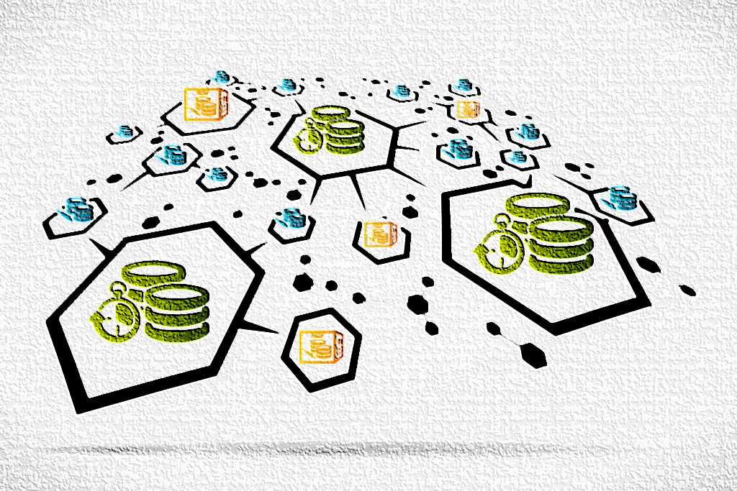
Data acquisition and cleaning:
The data needed for the analysis had been scrapped from different sources and mentioned below:
The neighborhood data of New York is provided here:
https://geo.nyu.edu/catalog/nyu_2451_34572
The neighborhoods of Toronto are extracted from here:
https://en.wikipedia.org/wiki/List_of_postal_codes_of_Canada:_M
The neighborhoods of Beijing are extracted from Wikipedia: https://en.wikipedia.org/wiki/List_of_township-level_divisions_of_Beijing
The neighborhoods of Shanghai are from:
https://en.wikipedia.org/wiki/List_of_township-level_divisions_of_Shanghai
Please note all my data and analysis are available in my GitHub page:
https://github.com/AravindanSurendran/The-Battle-of-Neighborhoods
Notes:
Insert a picture of one of the geographic features of your country.

Slide 4

Data acquisition and cleaning:
There are few outliers in the Toronto dataset and those has been removed. Renaming of columns was done for easy understanding. Some neighborhoods doesn't lie in Beijing boroughs, hence dropping it. The cleaned data was written into new csv files. Created a function to obtain the near by venues for each neighborhood with the help of FourSquare API. The analysis is made from the final dataset (combination of all 4 cities) with respect to venues.
Notes:
Insert a picture of one of the geographic features of your country.

Slide 5
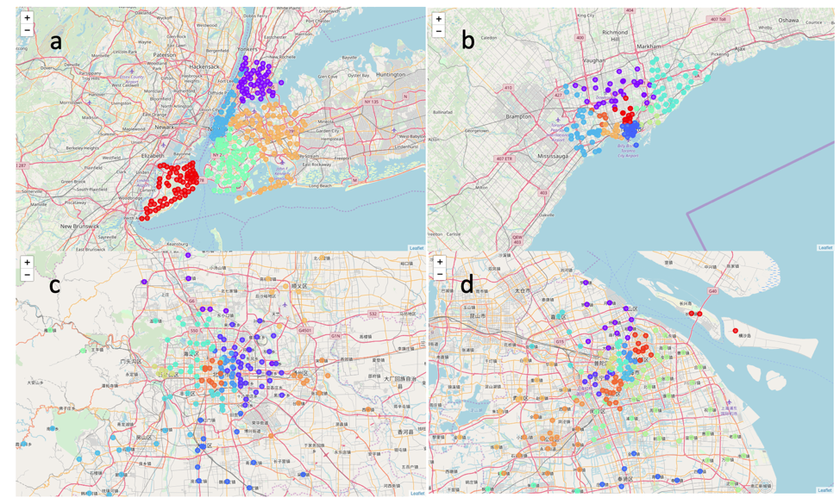
Methodology:
Data Preparation:
The New York data is available online with the neighborhood name and location information (latitude and longitude). For Toronto, Beijing and Shanghai, only neighborhood name is provided, I used the Nominatim library to obtain the location information by searching each neighborhood name. A number of neighborhoods are not found in Nominatim, I didn’t include these neighborhoods in my analysis. For those neighborhoods within the same borough, they were shown on map with the same label color. By doing so, it is easy to find that some neighborhoods jump into different color regimes, indicating wrong location information. These neighborhoods are further deleted.
Notes:
Insert a picture illustrating a season in your country.

Slide 6
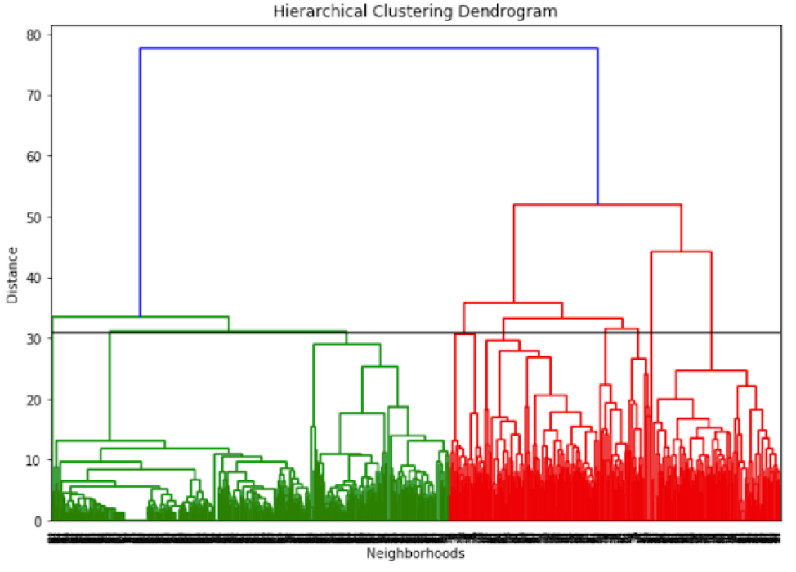
Methodology:
Data Analysis/Modelling:
According to the total number of venues in each category, I applied hierarchical agglomerative clustering method to compare neighborhoods among cities. Unlike k-means or other machine learning clustering methods, hierarchical agglomerative clustering doesn’t require the number of clusters at the beginning. Moreover, it could also tell us whether the dataset is good for clustering at first glance. To do so, firstly, I build a hierarchical clustering dendrogram with SciPy library. According to figure it is natural to separate the neighborhoods into 2 or 3 clusters. However, 2 or 3 clusters will just separate the neighborhoods into city center and suburb area, which doesn’t satisfy the goal of my study. To gain deeper insight from the dataset I decide to separate the neighborhoods into 9 clusters by cutting at the distance of 31. Secondly, I applied hierarchical agglomerative clustering of the sklearn.cluster library to cluster these neighborhoods.
Notes:
Insert a picture illustrating a season in your country.

Slide 7
RESULTS:
The below is the count of neighborhoods in each cluster obtained from hierarchical agglomerative clustering method .
Notes:
Insert a picture of an animal and or plant found in your country.

Slide 8
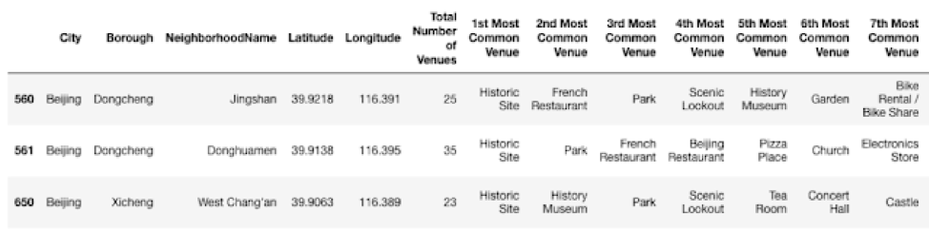
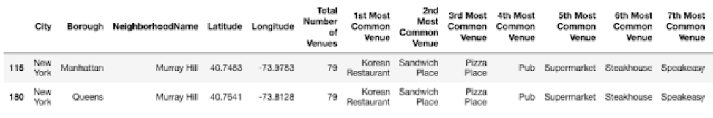
RESULTS:
Outliers: Cluster 5 and cluster 7
We not that Cluster 5 only has 3 neighborhoods and cluster 7 has only 2. These two clusters probably just contain the outliers. Cluster 5 is the historical area of Beijing; thus, no similar area was found in other cities. Cluster 7 is the same neighborhood throughout two boroughs, which is also unique in New York.
Neighborhoods in cluster 5
Neighborhoods in cluster 7
Notes:
Insert a picture of an animal and or plant found in your country.

Slide 9
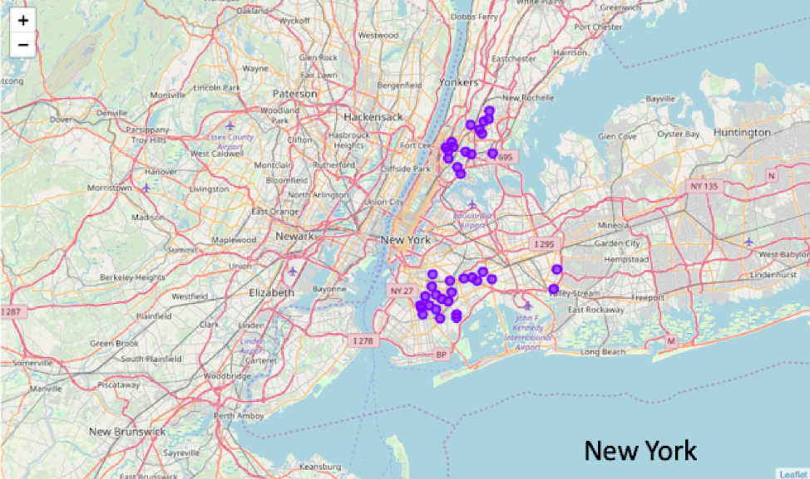
Results:
Cluster 0 :-
Cluster 0 contains the neighborhoods in New York with a lot of nearby pizza places, fast food restaurants and Caribbean restaurants.
Notes:
Add key points in the history of your country to the timeline.

Slide 10
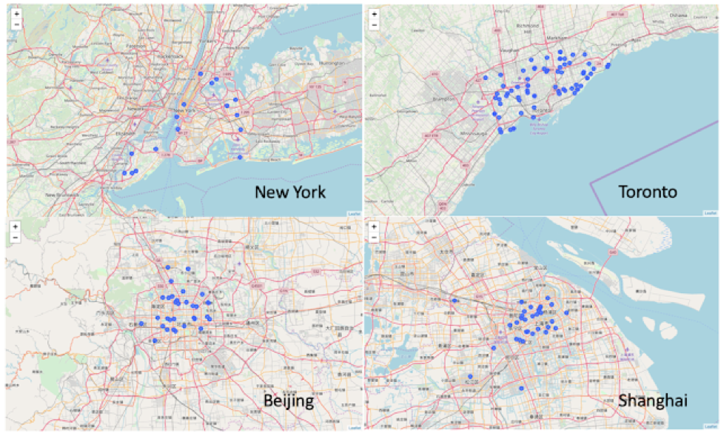
Results:
Cluster 1 :-
Cluster 1 is the residential area of each city. Each neighborhood has access to fast food restaurants and outdoor parks. There are also a lot of restaurants, convenience stores and supermarkets.
Notes:
Add key points in the history of your country to the timeline.

Slide 11
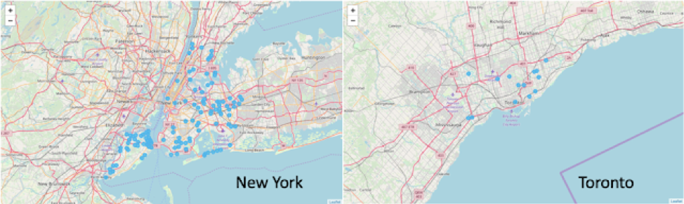
Results:
Cluster 2 :-
Cluster 2 represents venues in New York and Toronto neighborhoods with pizza places, banks, mobile phone shops nearby.
Notes:
Add key points in the history of your country to the timeline.

Slide 12
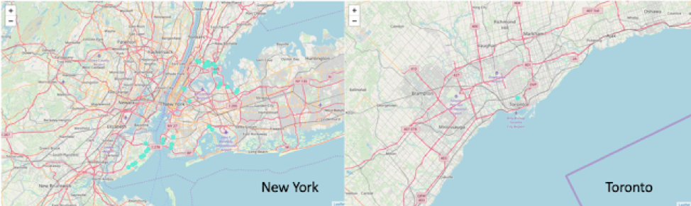
Results:
Cluster 3 :-
Most venues in cluster 3 are in New York neighborhoods with a lot of Italian and pizza places.
Notes:
Add key points in the history of your country to the timeline.

Slide 13
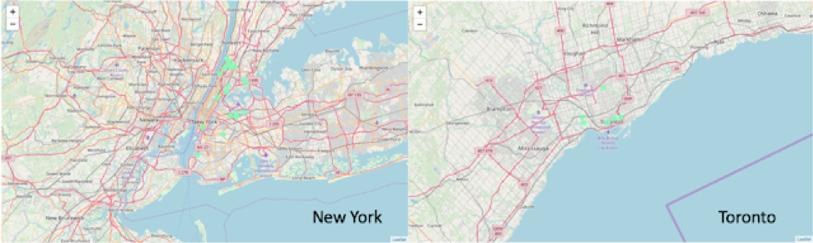
Results:
Cluster 4 :-
Cluster 4 includes the neighborhoods in New York and Toronto. These neighborhoods have a lot of dining place with Mexican and American cuisine.
Notes:
Add key points in the history of your country to the timeline.

Slide 14
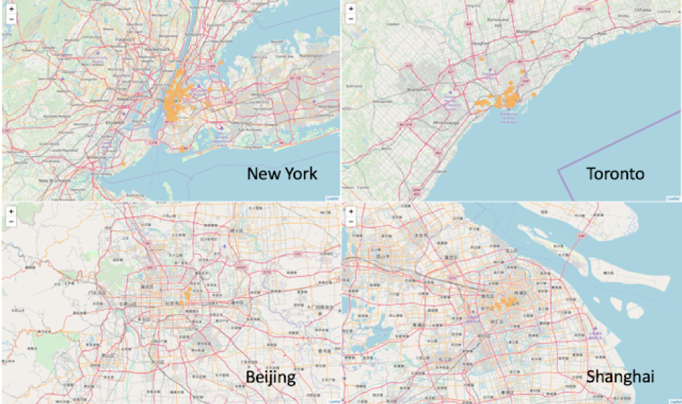
Results:
Cluster 6 :-
Cluster 6 is basically the city center where surrounded by a variety of venues, including theaters, parks, restaurants and bars. It includes the Manhattan area of New York and downtown Toronto.
Notes:
Add key points in the history of your country to the timeline.

Slide 15
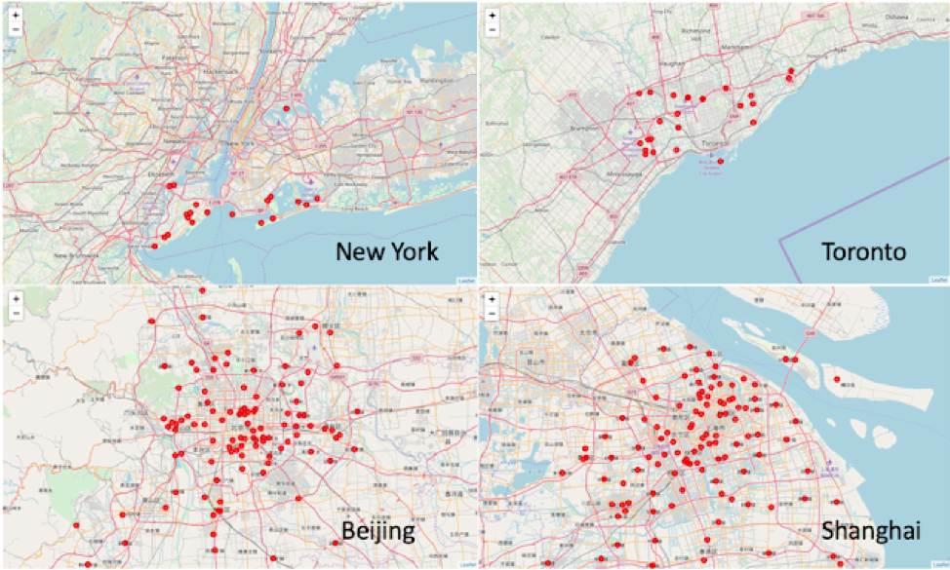
Results:
Cluster 8 :-
Cluster 8 contains the neighborhoods without much nearby venues, including the suburb of New York, Toronto and most parts of Beijing and Shanghai.
Notes:
Add key points in the history of your country to the timeline.

Slide 16
Discussion:
Overall, the results are not surprising. Toronto and New York are much more similar than Shanghai and Beijing, because they are much closer in location and have similar cultural background. Despite that, we were able to find some similar neighborhoods among these four cities. For those who are looking for a good residential area to settle down, neighborhoods in cluster 1 will be a good consideration. These neighborhoods are not crowded as city centers, but has a number of outdoor parks, restaurants and supermarkets. For those who have a job in the city center and don’t want to spend much time on transportation, neighborhoods in cluster 6 will be good. Please note that in cluster 8, it doesn't mean Beijing and Shanghai are less bustling. In fact, Beijing and Shanghai have even larger density of population. I think this is because the venue information provider Foursquare is located in USA, thus New York and Toronto have much more information than Beijing and Shanghai. Some venue providers located in China may help to have a more detailed analysis.
Notes:
Insert a picture illustrating a custom or tradition here.

Slide 17

Conclusion:
I hope I convince you that despite the distinct cultural and geographical location differences of New York, Toronto, Beijing and Shanghai, there are several similar neighborhoods in cluster 1, 2, 3, 4 and 6. I hope this could provide some useful information for people who are considering moving among Canada, USA and China.
Notes:
Insert a picture of the head leader of your country.

